Slide 2
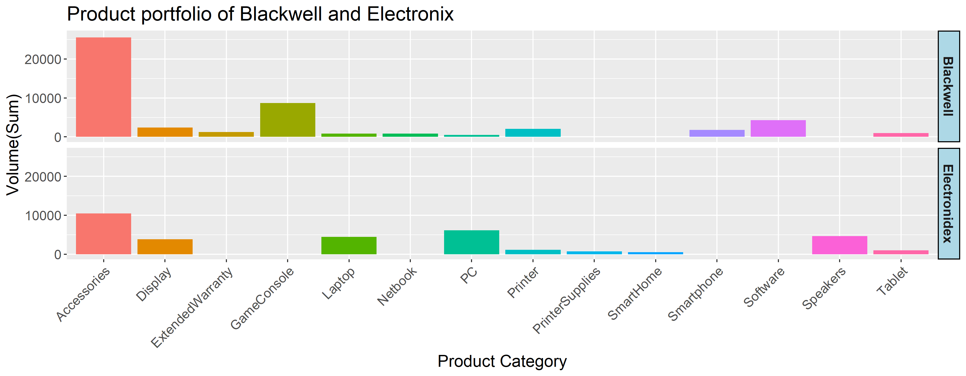

Slide 4
0.7
1.9
3.1
4.3
5.5
6.7
7.9
9.1
10.3
11.5
12.7
13.9
15.1
16.3
17.5
18.7
19.9
21.1
22.3
23.5

Slide 5
0.7
1.9
3.1
4.3
5.5
6.7
7.9
9.1
10.3
11.5

Slide 6
0.7
1.9
3.1
4.3
5.5
6.7
7.9
9.1
10.3
11.5

Slide 8
0.7
1.9
3.1
4.3
5.5
6.7
7.9
9.1
10.3
11.5
12.7
13.9
15.1
16.3
17.5
18.7
19.9
21.1
22.3
23.5

Slide 9
0.7
1.9
3.1
4.3
5.5
6.7
7.9
9.1
10.3
11.5

Slide 10
0.7
1.9
3.1
4.3
5.5
6.7
7.9
9.1
10.3
11.5

Slide 11
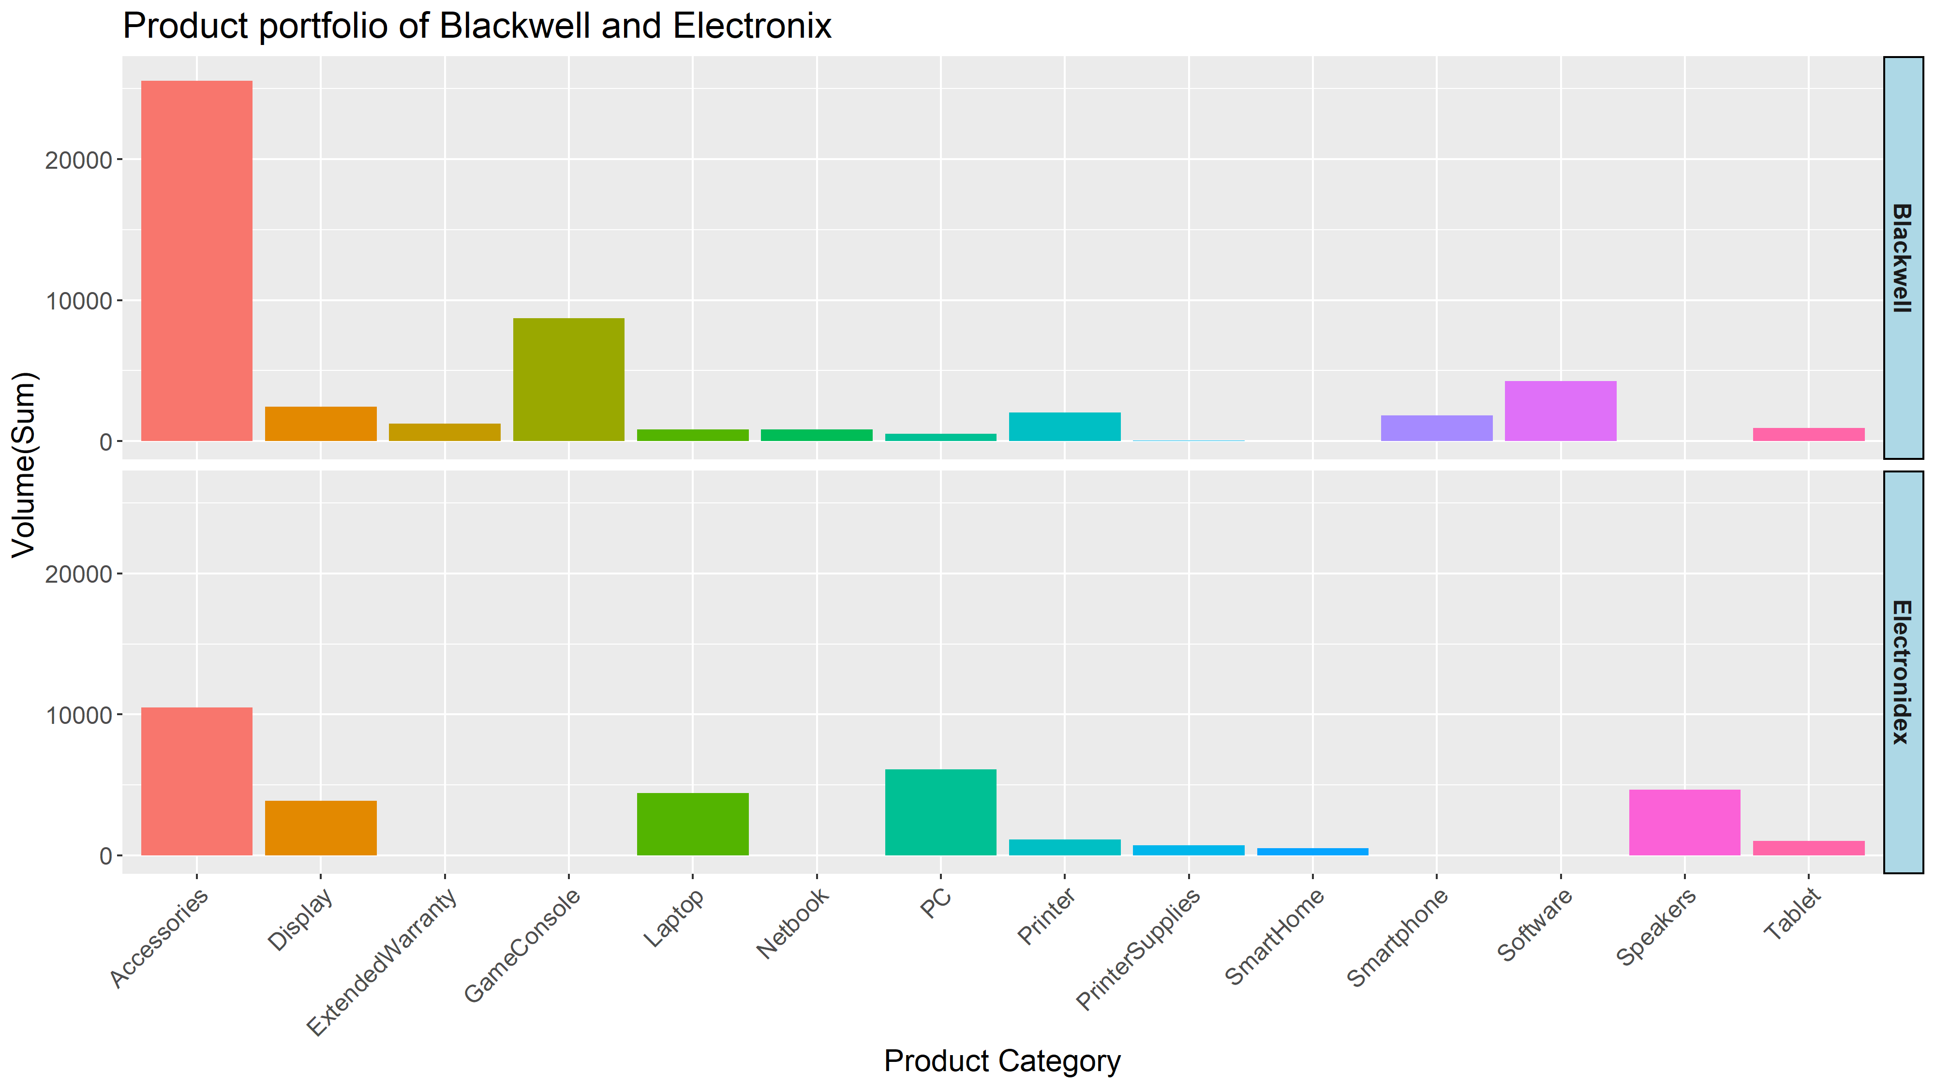

Slide 12
0.7
1.9
3.1
4.3
5.5
6.7
7.9
9.1
10.3
11.5
12.7
13.9
15.1
16.3
17.5
18.7
19.9
21.1
22.3
23.5

Slide 13
0.7
1.9
3.1
4.3
5.5
6.7
7.9
9.1
10.3
11.5

Slide 14
0.7
1.9
3.1
4.3
5.5
6.7
7.9
9.1
10.3
11.5

Slide 16
plot_iF_total

Slide 17
plot_iF_total

Slide 18
0.7
1.9
3.1
4.3
5.5
6.7
7.9
9.1
10.3
11.5

Slide 19
0.7
1.9
3.1
4.3
5.5
6.7
7.9
9.1
10.3
11.5

Slide 21
0.7
1.9
3.1
4.3
5.5
6.7
7.9
9.1
10.3
11.5

Slide 27
0.7
1.9
3.1
4.3
5.5
6.7
7.9
9.1
10.3
11.5

